Slide 1
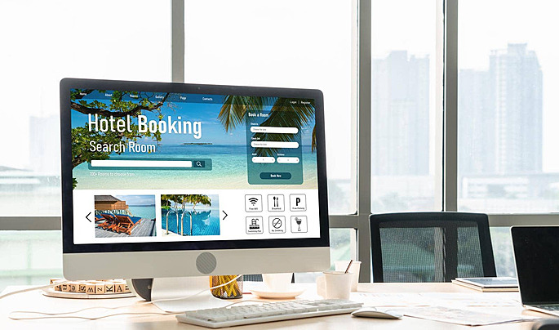
HOTEL BOOKING
ANALYSIS
PREPARED BY :- PARESH KARANDE
GUIDED BY: ABHISHEK WAVHAL

Slide 2
TABLE CONTENT
Introduction
Objectives
Dataset Overview
Data Processing
Exploratory Data Analysis/Data Visualization
Key Points
Tools and Technology
Conclusion

Slide 3
INTRODUCTION
This dashboard gives a clear view of hotel booking performance.
It helps us understand how many bookings were made, how much revenue was earned, and which countries and hotels performed the best.
The data also shows:
What types of customers are booking
Which market segments bring more business
How people are booking (online, travel agents, etc.)
With this information, we can make better decisions to increase bookings, improve customer satisfaction, and grow revenue.

Slide 4


GOALS AND OBJECTIVES
Goals:
To analyze hotel booking data and identify key trends.
To track performance across different hotel types and countries.
To support better business decisions through data insights.
Objectives:
Understand total bookings, revenue, and cancellations.
Compare performance between city and resort hotels.
Analyze customer segments and booking channels.
Identify areas to improve occupancy and profitability

Slide 5

DATASET OVERVIEW
The dataset contains detailed information about hotel bookings, including guest details, booking channels, stay duration, and other related factors.
Key Details:
Total Records: 119,390 bookings (approx.)
Hotel Types: City Hotel, Resort Hotel
Time Period Covered: 2015 – 2017
Main Columns Include:
Hotel type
Booking date and arrival details (day, month, year)
Number of adults, children, and babies
Lead time (days before check-in)
Country and market segment
Distribution channel
Room type and booking status
Average Daily Rate (ADR) and total revenue

Slide 6


DATA PRE-PROCESSING
Data Pre-Processing is Done in 2 ways:
Data Cleaning:
Remove Error, Remove Blank Records, Remove Duplicates, Identify
Primary Key, Identify Null Values in each column
Data Transformation:
Added Columns Booking ID, Arrival Date, Total Stay, Total No of Peoples
Customer Satisfaction, Total Revenue.

Slide 7
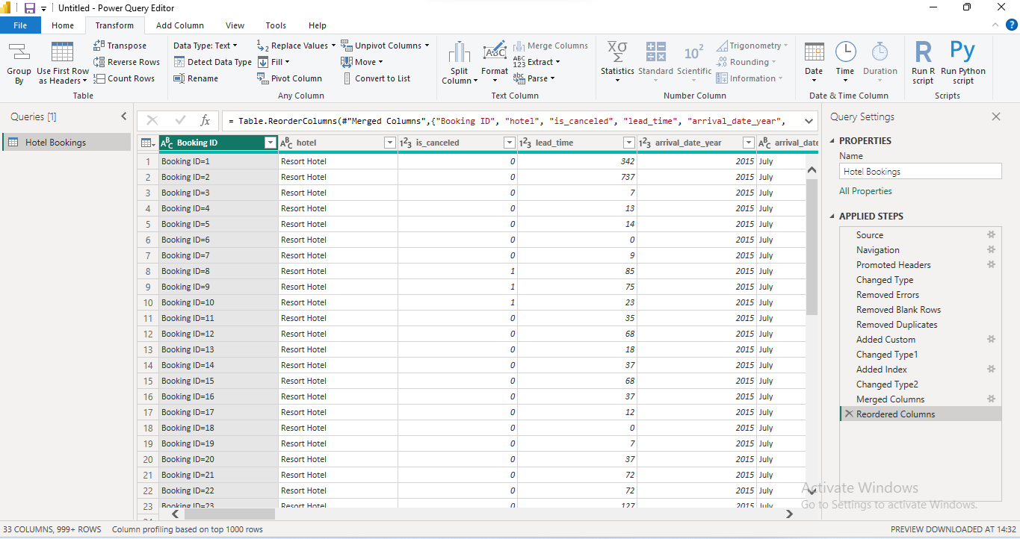
DATA CLEANING
Data Cleaning:
Remove Error, Remove Blank Records, Remove Duplicates, Identify
Primary Key, Identify Null Values in each column.

Slide 8
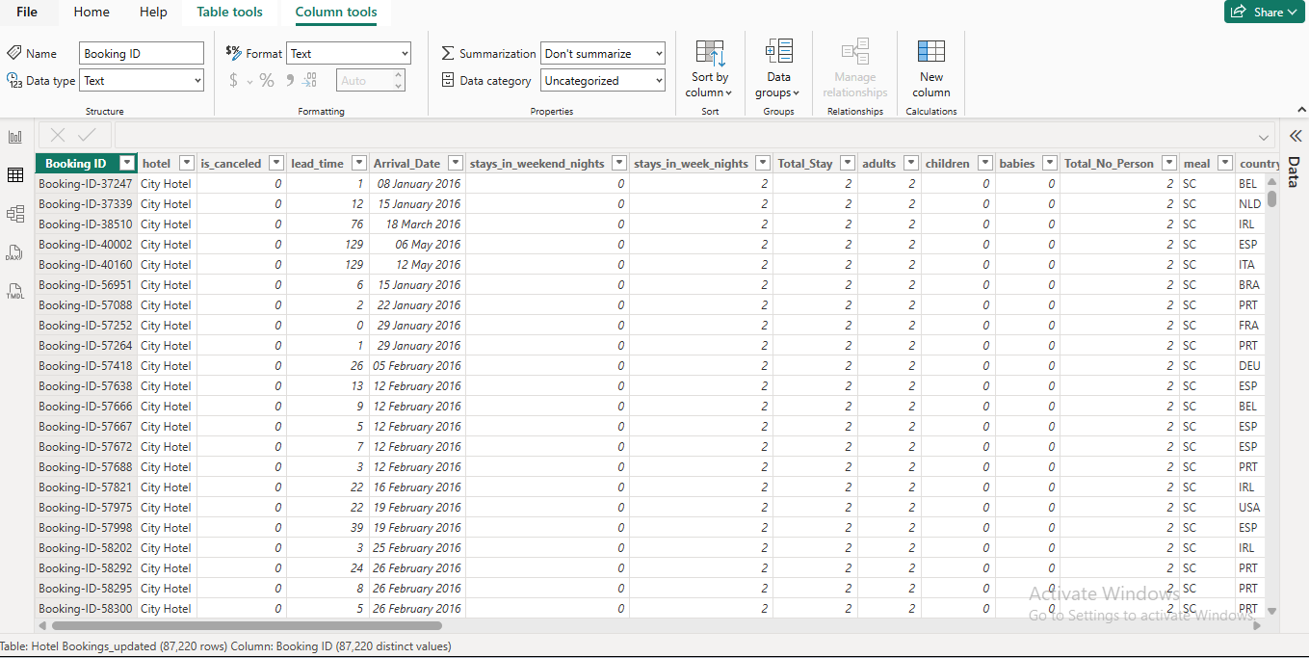
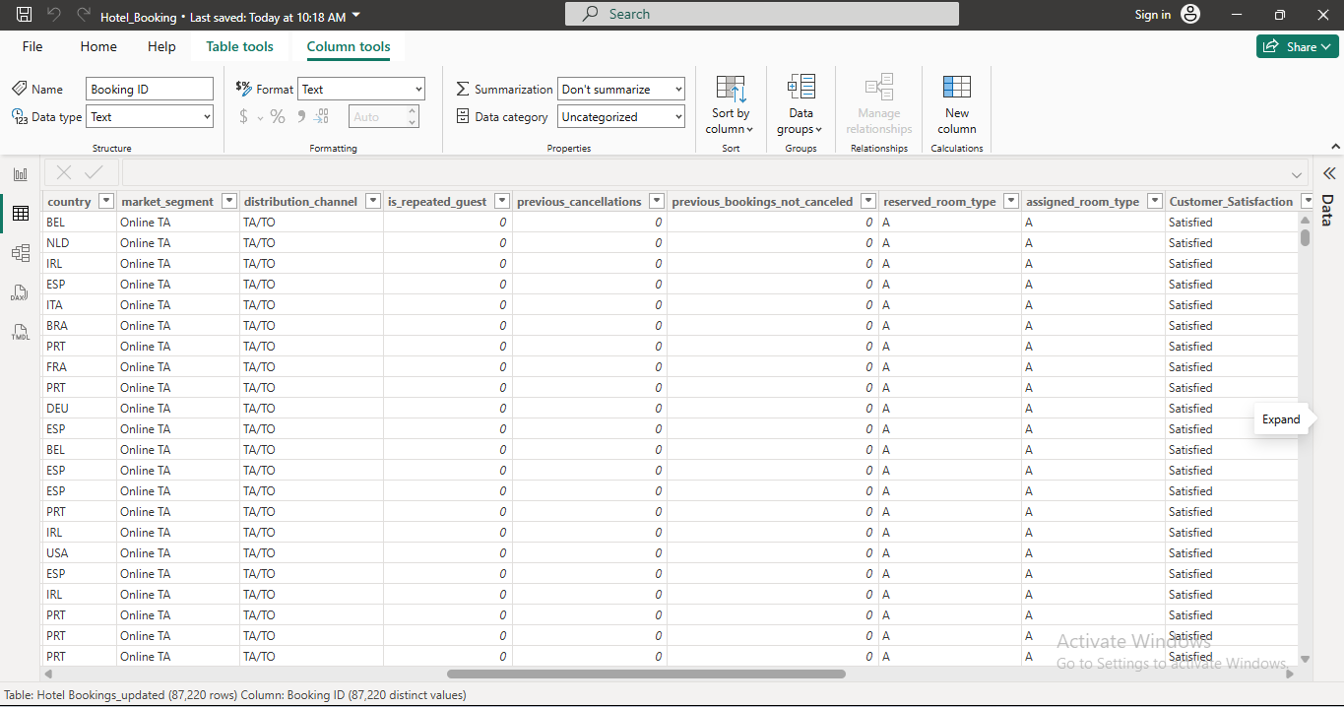
DATA TRANSFORMATION
Data Transformation:
Added Columns Booking ID, Arrival Date, Total Stay, Total No of Peoples
Customer Satisfaction, Total Revenue, Checked all columns datatype

Slide 9

EXPLORATORY DATA ANALYTICS
Here as we analyse data in the form Key Performance Indicator
And Different types of charts like Column chart,pie chart,line graph are use to see the trends in data and compare the values

Slide 10
KEY PERFORMANCE INDICATOR
Total Booking : 87.22K
Total Revenue : 34.45M
Total Country : 178
Avg ADR : 106.53
Avg Lead Time : 79.96
Total Person : 177K

Slide 11
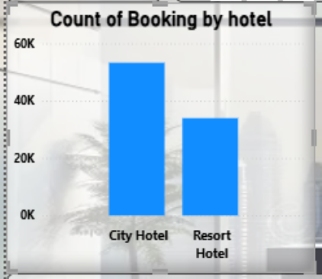
Chart Title : Total Booking By Hotel
Description:
This chart shows the total number of bookings made for each hotel type in the dataset.
The two hotel categories are:
🏙️ City Hotel
🏖️ Resort Hotel
Insights from the Chart:
City Hotel has a higher booking count — around 60K bookings.
Resort Hotel has a lower booking count — approximately 35K bookings.
This indicates that City Hotels are more frequently booked than Resort Hotels, possibly due to business travel, easier accessibility, or year-round demand.

Slide 12
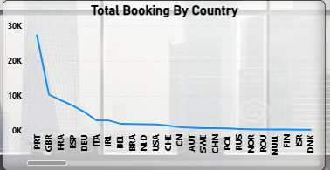
Chart Title : Total Booking by Country
Description:
This visualization represents the total number of hotel bookings grouped by country of origin (the guests’ country).
Each point on the line indicates how many bookings were made by customers from that specific country.
Insights:
Portugal (PRT) dominates bookings, nearly hitting 30K—far ahead of all other countries.
Emerging markets like China, Saudi Arabia, and Russia show low engagement—potential areas for growth.
Bookings are heavily concentrated in Western Europe, suggesting strong regional demand.

Slide 13
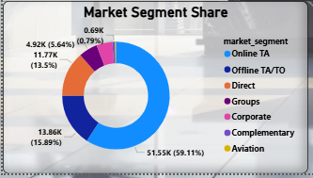
Chart Title : Market Segment Share
Description:
This chart shows the percentage share of total hotel bookings by different market segments.
Each segment represents a different source or type of customer booking channel.
Insights:
Online dominance: More than half of the bookings come via Online Travel Agents, highlighting the importance of digital marketing and online partnerships.
Offline still matters: With ~16% share, traditional agents remain important for customers who prefer personalized service or package deals.
Direct bookings are promising: 13.5% direct bookings show a good potential to increase profit margins by reducing commissions paid to OTAs.
Corporate and Group bookings: These are smaller but steady segments that can be grown through B2B partnerships and loyalty programs.

Slide 14
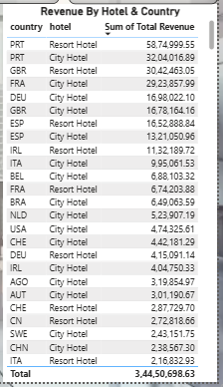
Chart Title :Revenue By Hotel & Country
Description:
The provided chart presents revenue data by hotel type and country. It shows the sum of total revenue in a tabular format, with country codes, hotel types, and corresponding revenue values.
Insights:
Resort Hotels outperform City Hotels, showing customers prefer leisure and holiday stays.
Top 5 countries (Portugal, UK, France, Germany, Spain) contribute over 70% of total revenue.
European markets dominate bookings; Asia and America have lower contribution.
Growth opportunity in countries like China, Austria, and Brazil through marketing expansion.

Slide 15
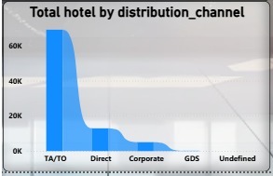
Chart Title : Total Hotel by distribution Channel
Description:-
This bar chart visualizes the total number of hotel bookings segmented by distribution channels, which are the methods through which bookings are made.
Insights:
TA/TO dominates — Most bookings come from Travel Agents/Tour Operators, highlighting their importance in driving sales.
Direct bookings show growth potential — can help reduce commission costs and increase profit margins.
Corporate bookings form a smaller portion — opportunity to expand via partnerships with companies and events.

Slide 16
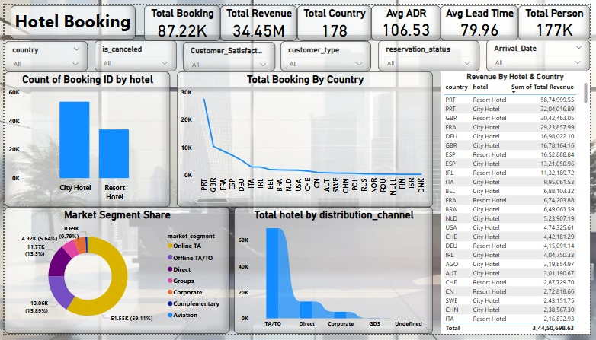
POWER BI DASHBOARD

Slide 17

TOOLS AND TECHNOLOGY
Data Cleaning Tool used : ETL (Power Query Editor),Excel
Data Visualization Tool used : Power BI

Slide 18

CUSTOMER KEY INSIGHT
The average lead time is 79.96 days, indicating customers generally plan well in advance before booking.
.Customer satisfaction appears high (as implied by strong booking and repeat customers across multiple countries).
City hotels attract more customers than resort hotels — likely due to convenience or business travel needs.
The major customer acquisition channel is Online TA/TO (Travel Agents/Tour Operators), contributing ~59% of bookings, showing customers prefer digital platforms.
Direct and corporate bookings form smaller segments, suggesting limited direct brand engagement.

Slide 19

REVENUE KEY INSIGHT
Total Revenue: $34.45M, across 178 countries — wide international reach.
Top Revenue Countries:
Portugal (PRT) – $58.7M (Resort Hotel dominates)
UK (GBR) – $30.4M
France (FRA) – $16.9M
Average Daily Rate (ADR): $106.53 — balanced pricing strategy between city and resort hotels.
Resort Hotels generate higher total revenue than city hotels due to higher room rates, even with fewer bookings.

Slide 20
BOOKING KEY INSIGHT
Total Bookings: 87.22K
Hotel Type Comparison:
- City Hotels have more bookings, showing higher occupancy.
- Resort Hotels have fewer bookings but higher revenue contribution.
Booking Source:
- TA/TO channel dominates (majority bookings and revenue).
- Direct and Corporate channels have much smaller shares.
Booking by Country:
- Top countries include Portugal, UK, France, Germany, Spain, and Italy.
- Long tail distribution shows users can target new markets with low booking volumes.

Slide 21
CONCLUSION
City Hotel leads in bookings and revenue
Heavy dependency on Online Travel Agents
Diverse and global customer base
High average lead time allows better demand forecasting
The average ADR ($106.53) and average lead time (~80 days) are healthy indicators for a balanced mix of short- and long-term bookings.
Early bookings are likely driven by seasonal planning (e.g., holidays, summer vacations), especially for Resort Hotels.
Given the reliance on online bookings, customer satisfaction likely influences repeat business and OTA ratings.

Slide 22
RECOMMENDATION
Promote Resort Hotels with offers or loyalty programs
Strengthen direct booking channels
Focus marketing on high performing countries (PRT,FRA,GBR)
Use dynamic pricing to optimize ADR
Encourage last-minute bookings with flexible deals.
Since lead times are long, cancellations can heavily impact revenue — implement flexible but controlled cancellation policies or early-bird benefits.
Analyze customer satisfaction data by market segment and country to tailor marketing campaigns.

Slide 23


